Slide 1
Sentiment Analysis and Visualisation of global COVID-19 vaccination plan using Naïve Bayes algorithm
By Tan Yi Hong

Slide 2
TABLE OF CONTENTS
01
02
03
INTRODUCTION
METHODOLOGY
DISCUSSION & CONCLUSION

Slide 3
INTRODUCTION
01

Slide 4
RESEARCH BACKGROUND
COVID-19 pandemic is one of the world's most serious threats
People are afraid of the effectiveness of vaccine
Carry out sentiment analysis and visualization towards their perception of vaccine
Notes:
Research background
From 2019 until now, The COVID-19 pandemic has emerged as one of the world's most serious threats, and it is still very much a concern. Many vaccines are available globally, such as Pfizer-BioNTech, Moderna, Johnson & Johnson / Janssen, AstraZeneca, CoronaVac, etc. While the vaccine has given the battle against COVID-19 a new lease of life, it has also sparked a wave of anti-vaccine protests. Many people out there are afraid of the effectiveness and also the dangerousness of the COVID-19 vaccine. This research project will carry out sentiment analysis and visualization towards their perception of vaccine.

Slide 5
PROBLEM STATEMENT
OBJECTIVES
Governments and scientists need to prove the success of the development of vaccines
Informative insights by visualisation will positively impact all people to be positive towards the vaccine
Crawl the resources from Twitter with Twint API
Classify the sentiment of the opinions on vaccination
Develop a classification model with Naïve Bayes approach
Visualise the data analysis and results to graphical charts
Notes:
Problem statement
With the ongoing vaccination campaign globally, governments and scientists need to prove and show the success of the development of vaccines to strengthen the confidence of all people to fight against COVID-19. Without a doubt, leading the successful effect of vaccination and informative insights by visualisation will positively impact all people to be positive towards the vaccine and believe that the vaccine is the life-saving key in the battle against COVID-19.
Objectives
· Crawl the resources from Twitter with Twint API to collect people's tweets about the vaccine-related topic. The language will be specified to only English.
· Classify the sentiment of the opinions on vaccination from the tweets collected to either positive, neutral, or negative.
· Develop a classification model with Naïve Bayes approach to applying in the real-world system that can manage to classify any sentences with the correct outcome.
· Visualise the data analysis and results to graphical charts to display valuable and informative insights

Slide 6
RESEARCH SCOPE
RESEARCH CONTRIBUTION
Build and Visualise the COVID-19 vaccination informations
Dataset will be crawled from Twitter using Twint API
Result will be visualised using several visualisation tools
Develop Sentiment Detector with GUI by using TKinter
Essential source of better insights about the public opinions towards the vaccination
Machine learning model will classify the type of sentiment.
Notes:
Research scope
The scope of this research project is to build and visualise the COVID-19 vaccination informations. And the dataset will be crawled from Twitter using Twint API. Then the result will be visualised using several visualisation tools such as Plotly and WordClouds. Lastly, a sentiment detector will be developed and implemented into the real-world system with GUI by using TKinter from the Python GUI resources
Research contribution
This project will contribute as an essential source of better insights about the public opinions towards the vaccination of COVID-19 in the current situation. The machine learning model will help classify the type of sentiment. The data visualization serves for an overall image to everyone, especially government and scientists, to decide their following action to encourage people to be confident with the COVID-19 vaccination.

Slide 7
METHODOLOGY
02

Slide 8

MACHINE LEARNING
LIFE CYCLE
Gathering Data -> Data preparation -> Data wrangling -> Analyse data -> Model Training -> Model Testing -> Deployment
Notes:
Machine learning life cycle
Step 1 - Gathering Data
It is to collect data, and integrate data obtained from Twitter using Twint API to get a coherent set of data called as a dataset.
Step 2 - Data preparation
This process starts with data exploration followed by data pre-processing and stored into dataframe.
Step 3 - Data wrangling
It is to clean and convert raw data into a usable format such as removing stopwords from texts and lemmatising the sentences to clean the data issues, such as invalid data and unreadable text.
Step 4 - Analyse data
This step is to build a Naïve Bayes model to analyse the data. This is to take the data and use machine learning algorithms to build the model.
Step 5 - Train the model
This step is to train the model to improve its performance for better outcome of the sentiment result.
Step 6 - Test the model
The model is checked for sentiment accuracy by providing a test dataset to it.
Step 7 - Deployment
The final Naïve Bayes model is deployed in the real-world system with GUI using Tkinter from Python GUI resources.

Slide 9
RESEARCH METHOD
Data Collection - Twint API
Text Cleaning - NLTK, spaCy, etc.
Data Visualization - Plotly, Wordclouds
Model GUI Design - Tkinter
Notes:
Research method
In this project, the data collected in the Tweets related to 'COVID-19 Vaccination' topics from Twitter. The tool that use to crawl the related Tweets is the Twint API. Twint is a Python-based advanced Twitter scraping application that allows you to scrape Tweets from Twitter profiles without using Twitter's API.
Next, text cleaning is to preprocess the data to become meaningful when interpret them. The data will be cleaned using several NLP libraries such as NLTK, spaCy and etc.
And then, the data visualisation for the COVID-19 vaccination tweets will be visualised to readable and informative graphical representation to show the sentiment progress, data analysis, and sentiment result. Furthermore, a visualisation like charts, graphs, tables, and graphical statistics will be constructed using multiple visualisation tools such as Plotly and WordClouds etc.
Lastly, the final selected Naïve Bayes model will be deployed and have a GUI by using the Tkinter.

Slide 10

EXPERIMENT TESTING
Disparity of preprocessed data and non-preprocessed data
Minor differences in raw data can lead to incorrect assumptions
Pre-processing the original dataset is crucial for this sentiment analysis research
Notes:
Experiment testing
Will be testing about the disparity of preprocessed data and non-preprocessed data when use for the data visualization to see the difference and the importance of data preprocessing. Minor differences in raw data can lead to incorrect assumptions. So, pre-processing the original dataset is crucial for this sentiment analysis research.

Slide 11
SYSTEM TESTING
Determine the capability of sentiment detector GUI system
Functional testing, interface testing, performance testing, and end user testing
Notes:
System testing
To determine whether the sentiment detector GUI system is capable of performing properly and meeting user needs. So, Functional testing, interface testing, performance testing, and end user testing will all be included in this testing phase. Because this is important for delivering a high-quality output.

Slide 12
DISCUSSION & CONCLUSION
03

Slide 13

ACHIEVEMENTS
Beneficial in gauging public opinion on the COVID-19 vaccine
Conduct sentiment analysis and calculate the percentage of people's replies
Sentiment detector to calculate the sentiment compound of the sentence
Notes:
Achievements
Employing sentiment analysis on recent Twitter data with the Twint API was beneficial in gauging public opinion on the COVID-19 vaccine. This study effort used the Nave Bayes approach to conduct sentiment analysis and calculate the percentage of people's replies that are positive, neutral, or negative feelings about the COVID-19 vaccination for final categorization, as well as visualize the data. Also, a sentiment detector is developed that will use VaderSentiment to calculate the sentiment compound of the sentence to predict the sentiment of the sentence accurately.

Slide 14
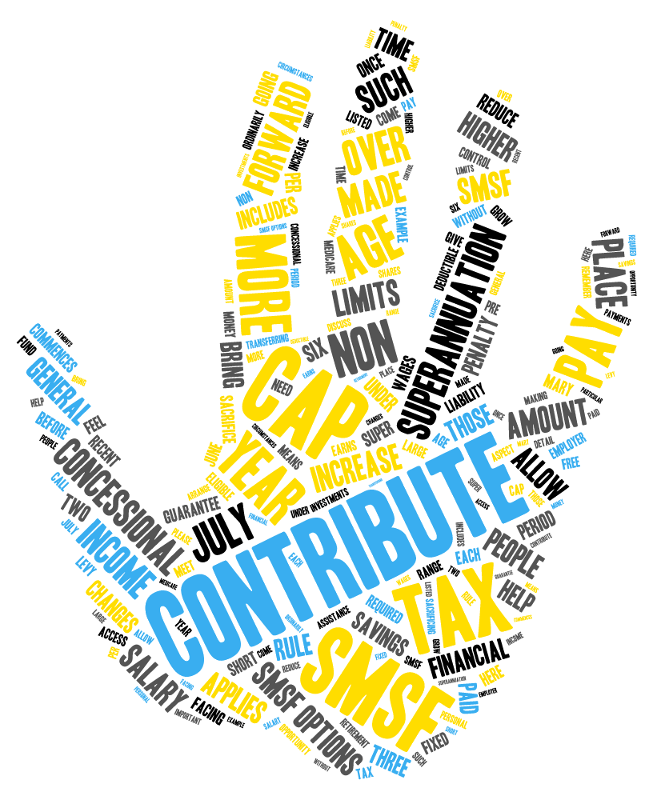
CONTRIBUTIONS
Vital source of better insights into public opinion
Classify the types of sentiment, and the results will be visualised
Give a better image to the government, scientists, and general public
Notes:
Contributions
This sentiment analysis research study contributes as a vital source of better insights into public opinion about COVID-19 vaccination. The machine learning model will help to classify the types of sentiment, and the results will be visualised for everyone. And with the data visualization, overall insight of the sentiment analysis based on the COVID-19 vaccination will give a better image to the government, scientists, and general public.

Slide 15


LIMITATIONS AND FUTURE IMPROVEMENTS
Dataset does not contain many meaningful columns
The use of TextBlob to calculate the polarity of each sentence
Crawl a dataset that contains more meaningful and interpretable columns
Find more tools that can calculate and predict the sentiment
Notes:
Limitations and future improvements
There are a few limitations for this research project. Firstly, the data that we crawled does not carry many columns that can use for data visualisation. And another issue, which is the use of TextBlob to calculate the polarity of each sentence, and assign the sentiment according to the polarity. The polarity produced by the TextBlob for each sentence will sometimes not so accurate
So, the future improvements for these limitations would be, to crawl a dataset that contains more meaningful and interpretable columns so to explore more and visualize the insights of this dataset to be more interesting and informative. Next, the sentence sentiment will not be assigned base on only the polarity that calculated by the TextBlob, but will find more tools that can calculate and predict the sentiment more accurately.

Slide 16
THANKS
Q&A

